Slide 1
World Bank Point of View
The Impact of Various Factors on Countries

Slide 2
Data Sources
World bank provided data for the countries and regions across the world in several different categories. The categories are termed as series_id in the world bank metadata. For the purpose of this project, the following series_ids were used in analysis
- https://data.nasdaq.com/databases/WB/data
* [United States](data/WB_DATA_USA.csv)
* [Nigeria](data/WB_DATA_NGA.csv)
* [China](data/WB_DATA_CHN.csv)
* [Saudi Arabia](data/WB_DATA_SAU.csv)
* [Germany](data/WB_DATA_DEU.csv)
* [Brazil](data/WB_DATA_BRA.csv)
* [Australia](data/WB_DATA_AUS.csv)
* [Electricity production from coal sources (% of total)](data/data_EG_ELC_COAL_ZS.csv)
* [Electricity production from hydroelectric sources (% of total)](data/data_EG_ELC_HYRO_ZS.csv)
* [Electricity production from natural gas sources (% of total)](data/data_EG_ELC_NGAS_ZS.csv)
* [Electricity production from nuclear sources (% of total)](data/data_EG_ELC_NUCL_ZS.csv)
* [Electricity production from oil sources (% of total)](data/data_EG_ELC_PETR_ZS.csv)
* [Electricity production from renewable sources, excluding hydroelectric (% of total)](data/data_EG_ELC_RNWX_ZS.csv)
* [Electricity production from renewable sources, excluding hydroelectric (kWh)](data/data_EG_ELC_RNWX_KH.csv)

Slide 3
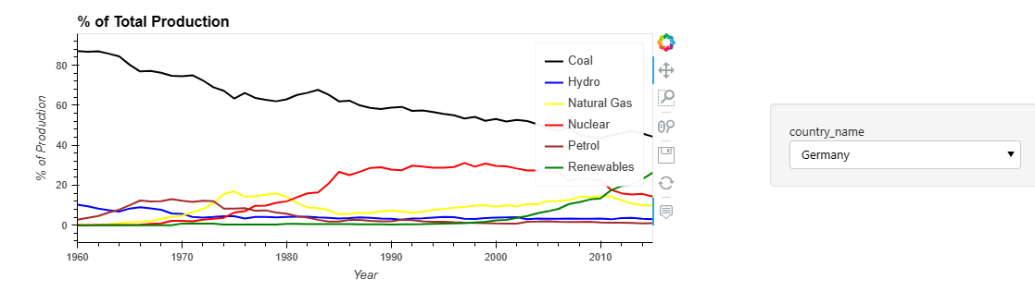
Electricity Production from sources
Germany produced 25% of its electricity from renewable sources (excluding hydroelectric) – which is the highest in any of the leading economies in the region

Slide 4
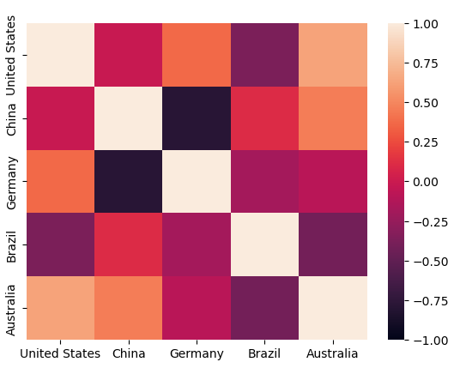
Is there a race amongst the leading economies
There is no identifiable pattern between the leading economies in producing electricity from Coal
Germany and China are negatively correlated.

Slide 5
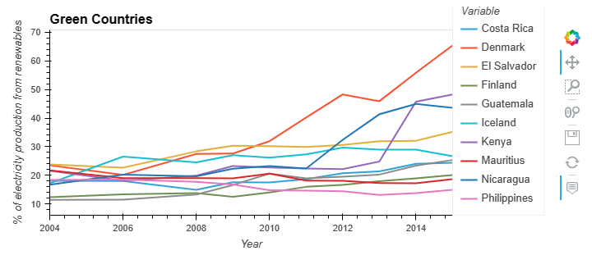
Green Countries
From a percentage standpoint, smaller countries have shown promise and increasing the electricity production from renewable resources from anywhere between 10-22% to 18-65%

Slide 6
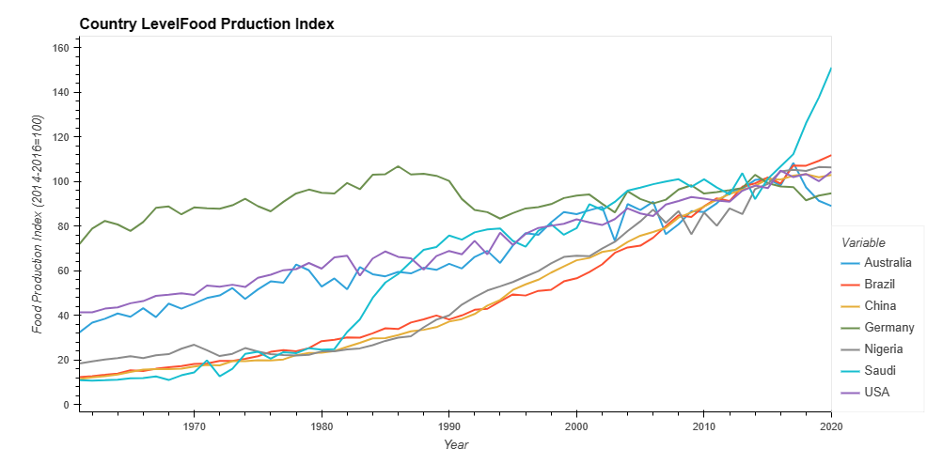
Food Production Trends
Growth in food production level for all countries
Germany has the lowest growth trend in the period.

Slide 7
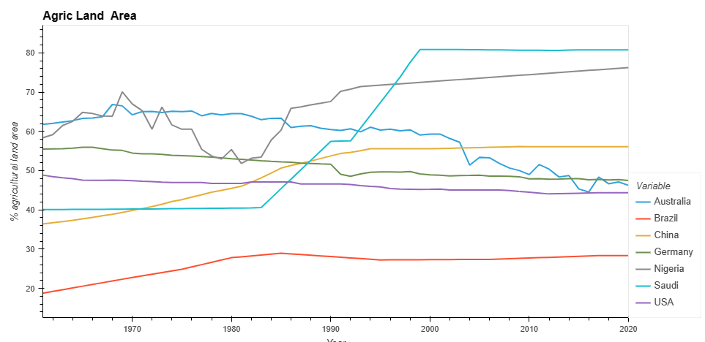
Agriculture Land Area Trends
Saudi Arabia doubled agric land area from 40.6% to 80.8%
Nigeria declined between 1970 and 1981 from 70.06% to 51.8% . Then went back to 70.7% between 1982 and 1992 .
Germany and United States registered a decline during the review period

Slide 8
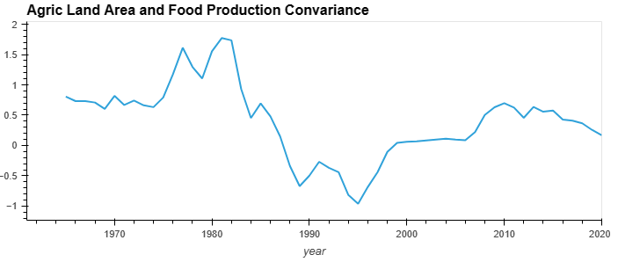
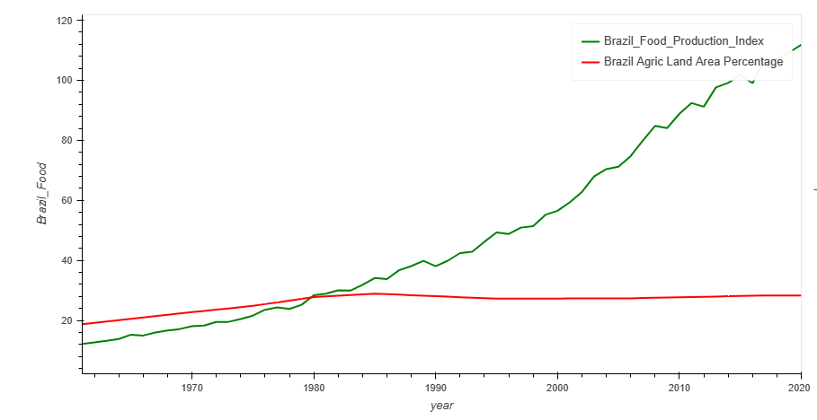
Brazil Agric Land Vs Food Production
Brazil has strong positive correlation between the agriculture land area and the food production to around 1985
After 1986 food production level increased although percentage of agriculture land area was constant.

Slide 9
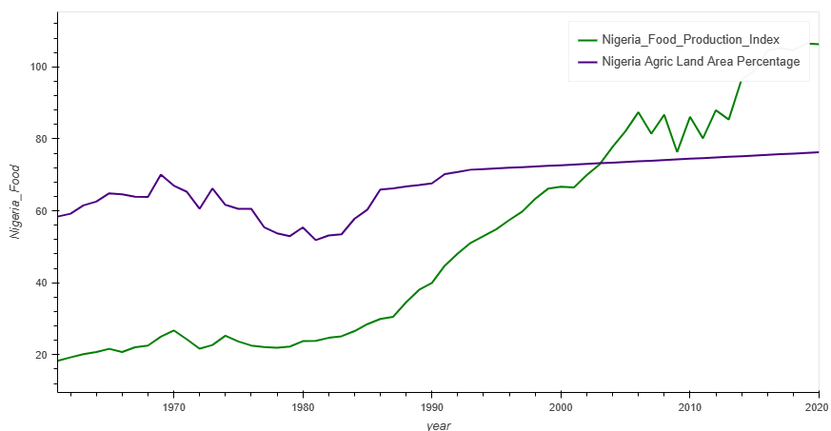
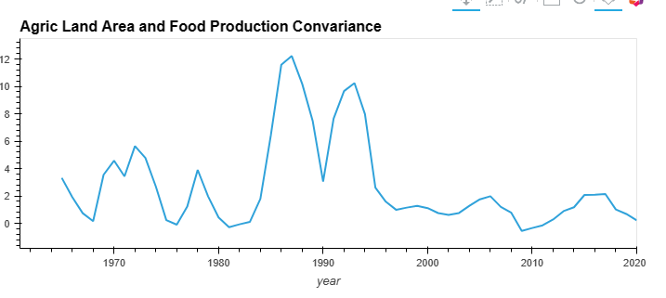
Nigeria Agric Land Vs Food Production
Nigeria Food production index was below the agriculture land area up 2003 when this trend reversed.
Strong positive relationship between Food production value and agriculture land area for Nigeria.

Slide 10
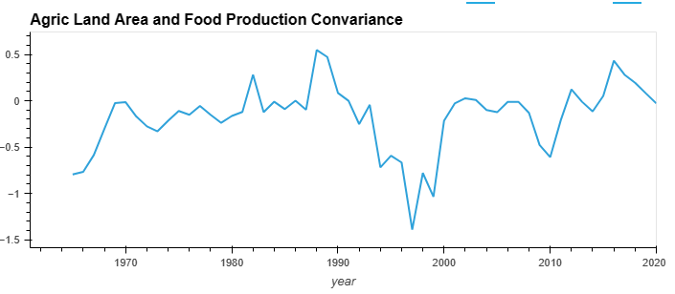
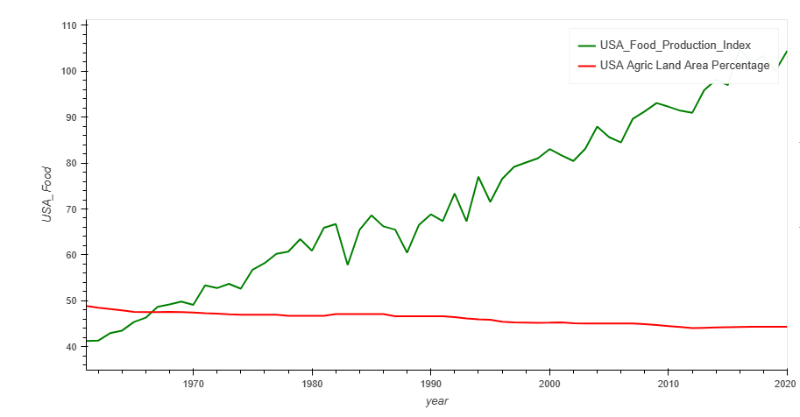
USA Agric Land Vs Food Production
USA had weak correlation between the agric land area and the food production levels ranging between -1.5 and 0.5

